Slide 1
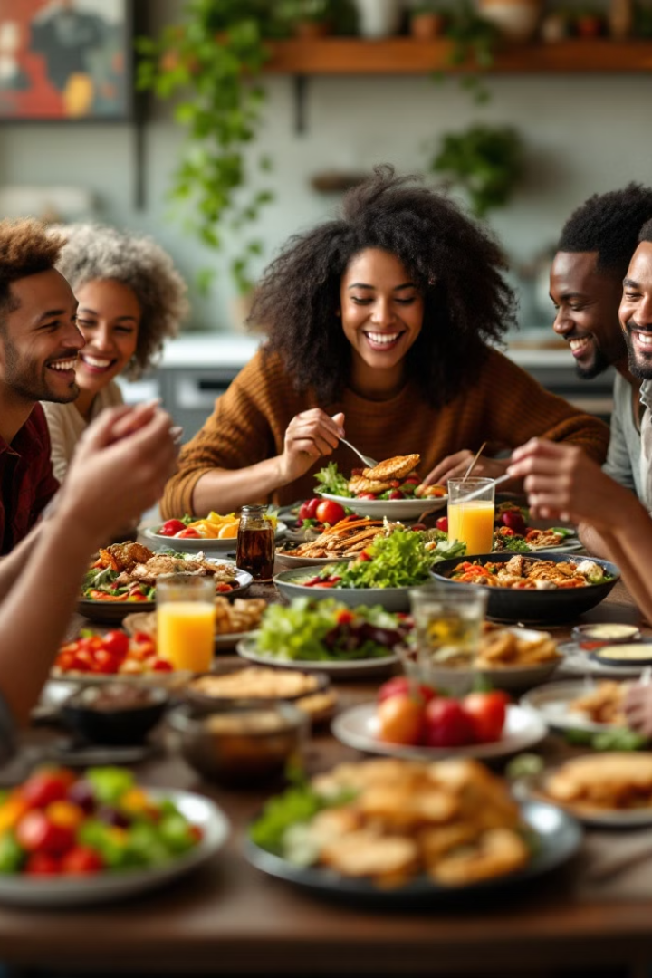
HealthMate: Revolutionizing Dietary Health
Connecting users with verified doctors.
Notes:
Good Evening! Now, before we dive in, let me ask—how many of you have spent way too much time Googling things like ‘Is coffee actually a vegetable?’ Yeah, we’ve all been there. Well, that’s why we’re here today with HealthMate—an app that’s going to make figuring out your diet a whole lot easier. Whether you’re team bacon or team broccoli, we’ve got you covered

Slide 2
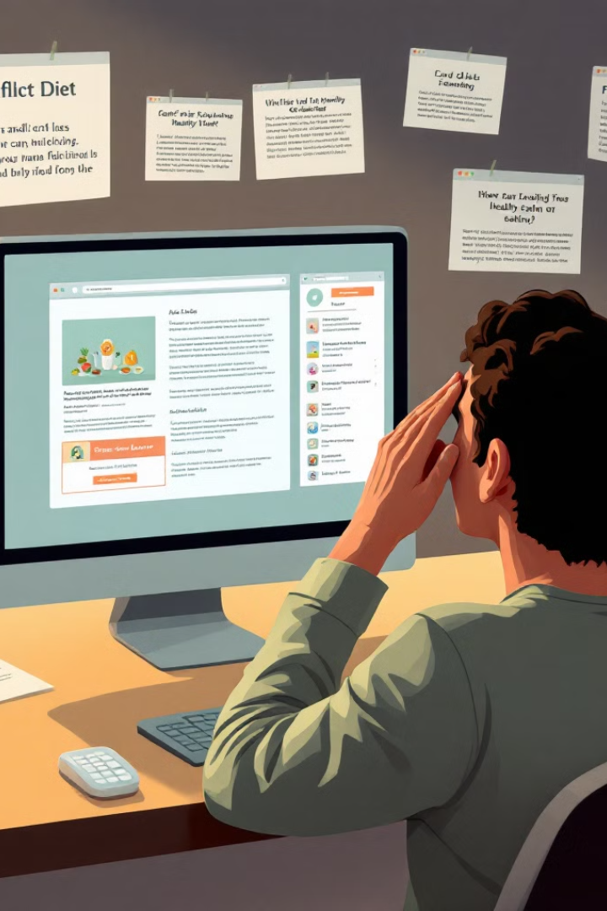
What's Cooking? The Problem
1
Information Overload
Conflicting diet information online.
2
Need for Credibility
Personalized, reliable advice needed.
3
Lack of Community
Missing support and shared experiences.
Notes:
Here’s the deal: The internet is full of conflicting diet advice. One day, kale is saving your life, the next, it's apparently destroying it. It’s overwhelming. What people really need is trusted, personalized advice—especially when it comes to something as important as what they put on their plate. But current apps and forums are unreliable and don’t create the kind of engaging, trustworthy environment we need

Slide 3
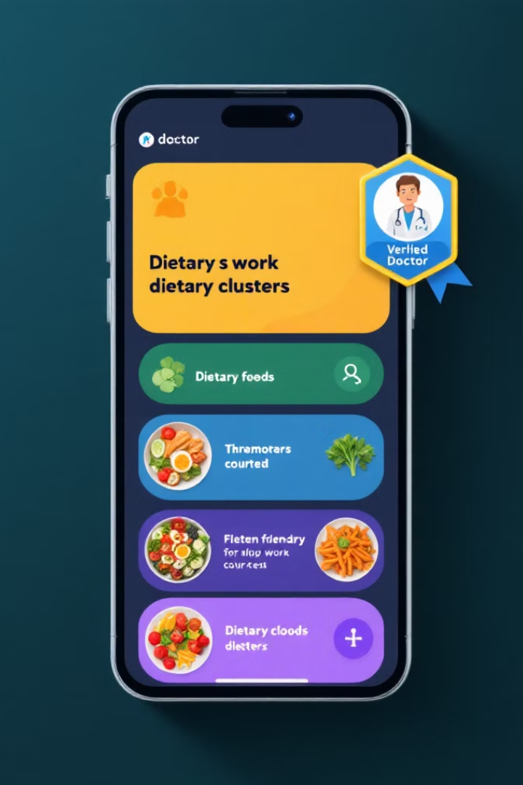



HealthMate: The Solution
Diet-Based Clusters
Connect with like-minded individuals.
Anonymous Interaction
Open discussions without judgement.
Verified Doctors
Trusted, credible health advice.
Notes:
So, how does HealthMate solve this? First, we group users into diet clusters. Whether you’re all about meat, plants, or a mix of both, we’ve got your tribe. Then, we give you the freedom to ask anything anonymously—because, let’s face it, no one wants to admit they’ve Googled ‘Can I live on donuts alone?’ And finally, we only allow verified doctors to give health advice, so no more reading advice from 'Dr. Google

Slide 4
User Verification & Trust
Doctor Verification
Community Moderation
Doctors must submit their credentials (medical license, certifications) to be reviewed by our team. Verified doctors are flagged with a special badge, clearly distinguishing them from regular users.
A combination of automated content moderation and manual review by healthcare professionals ensures misinformation is flagged and corrected. Verified doctors can also mark answers as "trusted" to guarantee accuracy.

Slide 5
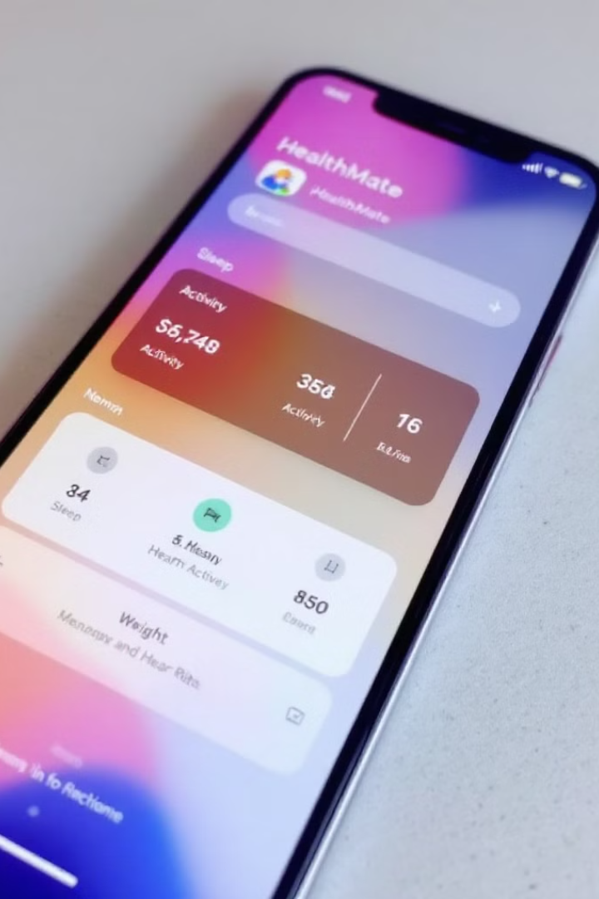




Core Features
Sign-Up & Segmentation
Categorized by dietary preferences.
Anonymous Interaction
Safe space for open discussion.
Doctor Verification
Ensuring credible advice.
Smart Clustering
Personalized interaction.
Notes:
Let’s walk you through how this works. First, we start with sign-up. You tell us what diet you follow—are you a hardcore carnivore or a plant-lover? Then, we automatically place you into a cluster where you can interact with like-minded people. You can post your questions anonymously, and when a certified doctor replies, you know it’s real. Here’s how the doctor verification badge looks—so you’ll never mistake a blog junkie for a professional.

Slide 6
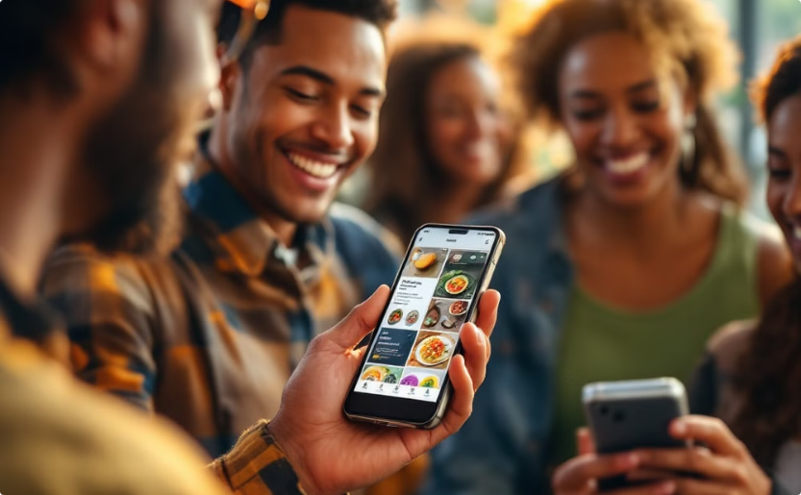

User Engagement & Retention
User Engagement
Doctor Retention
Users can participate in daily or weekly challenges that encourage healthy habits. They can share recipes and meal plans, track their progress, and receive personalized tips from verified doctors.
HealthMate offers a revenue-sharing model for doctors. They can charge for consultations, earn points for answering questions, and receive special recognition based on their engagement level.

Slide 7


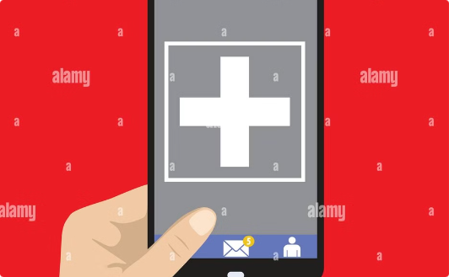
Revenue Model
Freemium Model
Targeted Ads
Affiliate Marketing
Free access, paid consultations.
Health-related brand partnerships.
Promoting health products.
Notes:
Now let’s talk business. We’re not just about improving health, we’re about making it sustainable, too. Our revenue model starts with a freemium structure—basic access is free, but if you want premium features like personalized doctor consultations or health tracking, that’s part of our subscription. We also see opportunities in ads—non-intrusive, of course—from health-related brands. And then, we’ve got affiliate marketing. If you’re buying that fancy juicer, why not do it through HealthMate

Slide 8


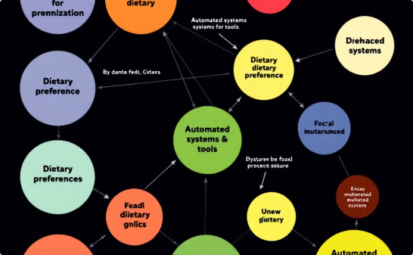
Scalability and Growth
Scalable Technology
Global Expansion
Evolving Community
HealthMate is built for growth, leveraging robust technologies like Firebase and MongoDB to ensure seamless performance as the user base expands.
We'll expand our reach with multi-language support, opening the app to a global audience. We'll also introduce new features beyond dietary clusters, like fitness, mental health, and more.
Automated clustering and moderation tools will keep pace with our growing user base, ensuring a positive and insightful community experience. We'll leverage cloud hosting solutions like Heroku or Firebase, allowing for dynamic scalability as demand increases.
Notes:
Now, scalability—HealthMate isn’t just a niche app. It’s designed to grow. We can easily add clusters for other health interests—mental wellness, fitness, even corporate wellness programs. Imagine your office giving you access to personalized health advice as part of their employee care package. Our goal is to make this app a global player in health and wellness

Slide 9
Competitive Landscape
MyFitnessPal
Lacks anonymity, verified doctors.
Zocdoc
No community forums or clustering.
Reddit Communities
Unregulated advice, reliability issues.
Lifesum
Focuses on Healthy eating but No verified doctos
Noom
No community forums
HealthTap
Provides access to doctors who answer questions, but does not group users based on dietary preferences or interests
Notes:
So, what sets us apart? First off, our doctors are verified. Only certified healthcare professionals can dish out advice—so you know you're getting the real deal. Second, the anonymity encourages people to ask those embarrassing questions they’d otherwise keep to themselves. And finally, our focus on dietary health fills a gap that no other app has fully captured.

Slide 10

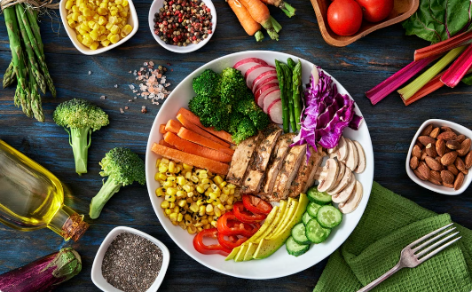
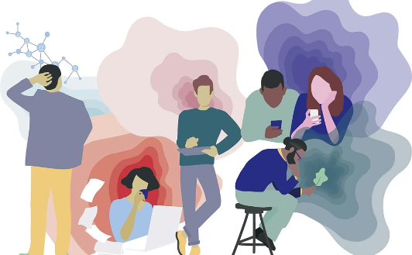
Future of Diet Docs
Expert Content
Diet care
Mental well being
More expert-led resources.
Clusters help people to know more about thier diets
Peoples mental health is taken care
Notes:
In the future, we plan to integrate real-time health tracking, allowing users to sync their wearable devices and get personalized advice based on actual data. We’ll also add recipe sharing, so you can swap your grandma’s vegan cookie recipe with fellow users, and diet challenges, to keep users engaged and motivated to meet their health goals

Slide 11

Conclusion: Join the Feast!
Healthier Communities
Empowering informed choices.
Expert-Led Guidance
Trusted advice for better health.
Be Part of the Movement
Join HealthMate today.
Notes:
At the end of the day, HealthMate is all about building healthier communities through personalized, expert-driven advice. Whether you’re struggling to pick the right diet or just want to swap healthy recipes, we’ve got a place for you. So, come join us in making the world a healthier, happier place—one anonymous post at a time

Slide 12
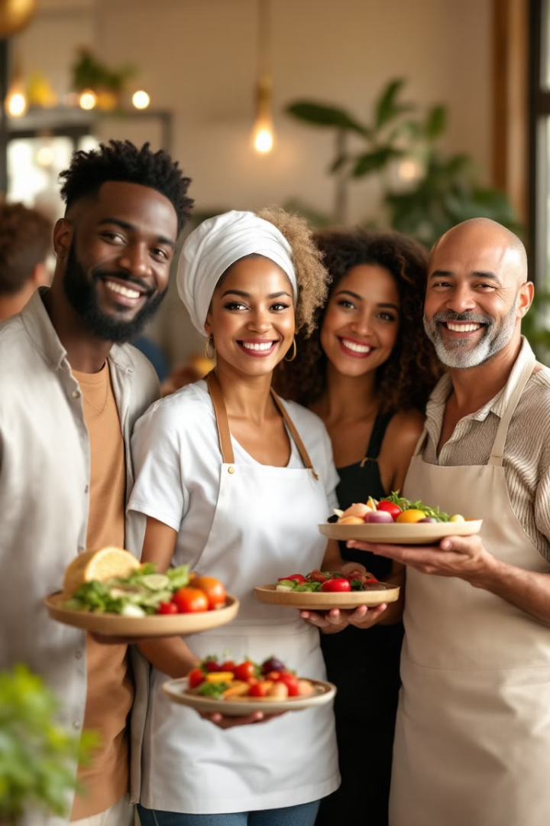
Thank You!
We appreciate your time and interest in HealthMate.
We are excited to share our vision for a healthier future.

