Slide 1
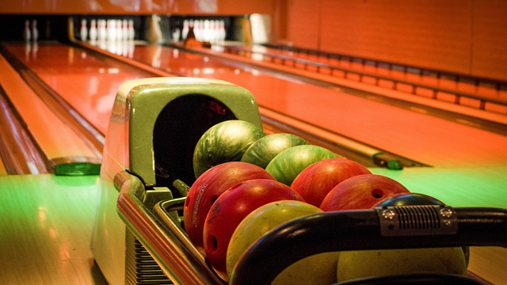
INTRODUCTION
TEAM NAME:- ILLUMINATI
NAGABHUSAHAN PATIL
HEMANG THAKER

Slide 2

AGENDA
Introduction
Executive Summary
Problem Statement
SWOT Analysis
PESTEL Analysis
Key findings: Customer analysis
Key findings: Marketing analysis
Recommendation
Conclusion

Slide 3
EXECUTIVE SUMMARY/ABSTRACT
Introduction to the case study on Givens' contemplation of Sugar Bowl's future.
Sugar Bowl offers an urban lounge and bowling concept for diverse clientele.
Givens reflects on the business's success and challenges, emphasizing cost management.
Uncertainties surround the long-term viability of the business model.
Givens faces pressures to manage debt, meet investor expectations, and consider her career growth.
Aim to explore entrepreneurship, financial management, and personal ambition in Sugar Bowl's context.
Provides insights into navigating challenges and seizing opportunities in the entertainment industry.

Slide 4





PROBLEM STATEMENT
A well-known bowling center came up with an urban lounge concept, it is facing major
obstacles that endanger its long-term viability and profitability.
The main challenges include declining profits, heightened competition, and evolving consumer preferences,
all of which threaten the business's ability to thrive in the market.
There was an urgency of addressing these challenges which is underscored by the business's fluctuating financial performance, evident in its quarterly reports.
Given’s concern about time management and are her personal sacrifices worth it
A possible sales offer and an arising job opportunity for the owner are examples of outside variables that increase the pressure to show Sugar Bowl's flexibility and resilience and to continue the enterprise on a long-term basis.

Slide 5
SWOT ANALYSIS
Strengths
Weakness
Strong Emotional Connection
Financial Debt
Unique Business Concept
Uncertain Industry Outlook
Financial Potential
Reliance on Owner's Leadership
Management Experience
Operational Challenges
Opportunities
Threats
Sale Potential
Industry Competition
Career Growth
Unique Business Concept
Diversified Revenue Streams
Changing Consumer Preferences
Strategic Partnerships
Operational Risks

Slide 6
PESTEL ANALYSIS
Political
Government Regulation
Tax policies
Economical
Economic Conditions
Exchange rates
Social
Demographic trends
Cultural preference
Technical
Advancement in Technology
Economical
Sustainable initiatives
Legal
Health and Safety Regulations
Licensing and permits

Slide 7
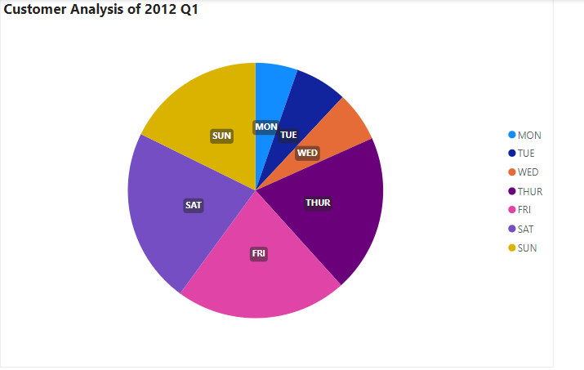
KEY FINDINGS:CUSTOMER ANALYSIS
Higher customer inflow during the weekends
Alternative required during first 3 day of the week

Slide 8
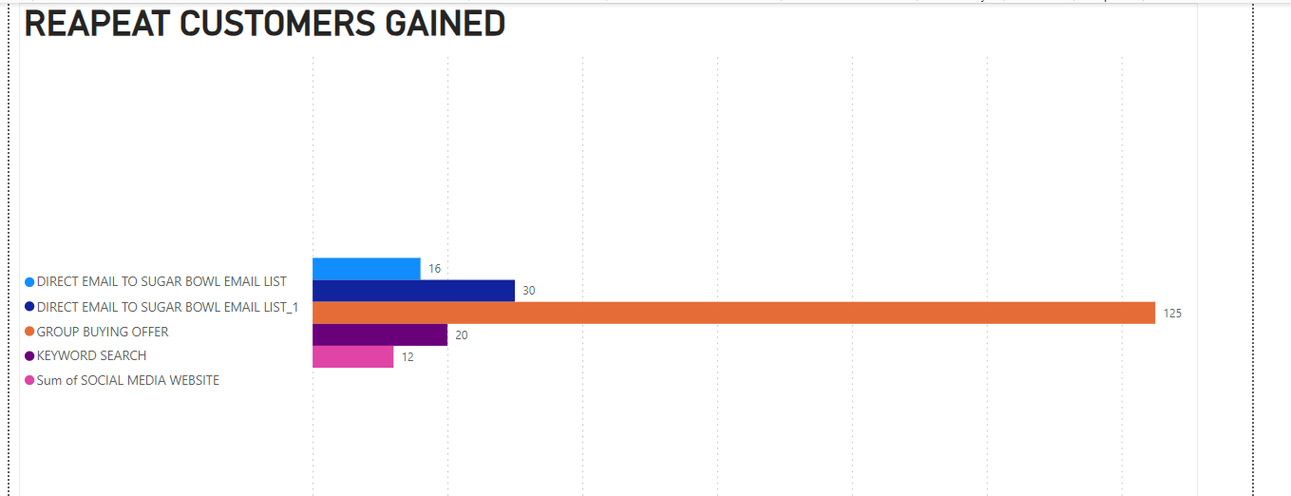
KEY FINDINGS:MARKETING ANALYSIS
Keyword search and direct email to sugar bowl list has the lowest cost per generated customer at $27.50.
Stop using rented email target list.
Group buying offer can be used to attract large customers in short time span.

Slide 9
RECOMMENDATIONS
Hosting standup comedians , musicians and promoting other talents
Introducing point system in the alley
Hosting Bowling competitions
Introducing student discount to attract students
Introducing variable orders of food

Slide 10
CONCLUSION
Critical Decisions
Strong Path
Opportunity vs. Tradition
Career
Market Understanding
Entrepreneurial aspect
The role of consultant
Framework for Decision with time management

